Slide 1
Recursion
Chapter 7
Data Structures and Abstractions with Java, 4e
Frank Carrano
© 2015 Pearson Education, Inc., Upper Saddle River, NJ. All rights reserved.

Slide 2
What Is Recursion?
Consider hiring a contractor to build
  He hires a subcontractor for a portion of the job
  That subcontractor hires a sub-subcontractor to do a smaller portion of job
The last sub-sub- … subcontractor finishes
  Each one finishes and reports “done” up the line
© 2015 Pearson Education, Inc., Upper Saddle River, NJ. All rights reserved.

Slide 3
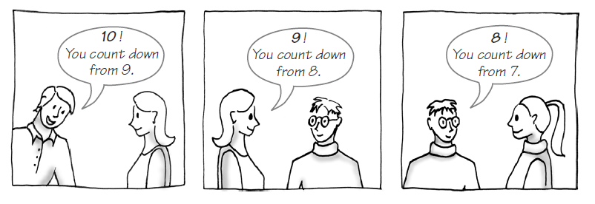
Example: The Countdown
FIGURE 7-1 Counting down from 10
© 2015 Pearson Education, Inc., Upper Saddle River, NJ. All rights reserved.

Slide 4
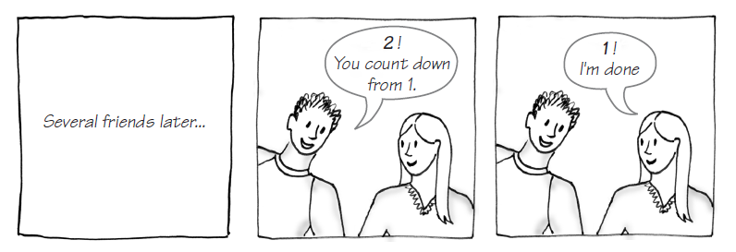
Example: The Countdown
FIGURE 7-1 Counting down from 10
© 2015 Pearson Education, Inc., Upper Saddle River, NJ. All rights reserved.

Slide 5
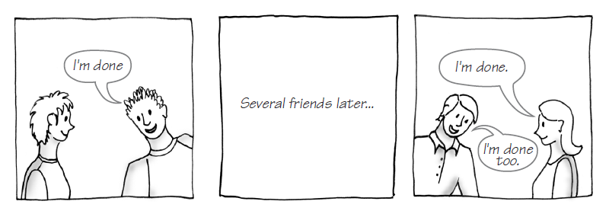
Example: The Countdown
FIGURE 7-1 Counting down from 10
© 2015 Pearson Education, Inc., Upper Saddle River, NJ. All rights reserved.

Slide 6
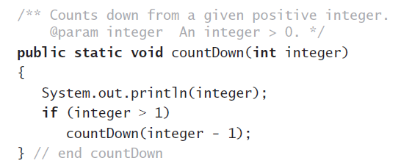
Example: The Countdown
Recursive Java method to do countdown.
© 2015 Pearson Education, Inc., Upper Saddle River, NJ. All rights reserved.

Slide 7
Definition
Recursion is a problem-solving process
  Breaks a problem into identical but smaller problems.
A method that calls itself is a recursive method.
  The invocation is a recursive call or recursive invocation.
© 2015 Pearson Education, Inc., Upper Saddle River, NJ. All rights reserved.

Slide 8
Design Guidelines
Method must be given an input value
Method definition must contain logic that involves this input, leads to different cases
One or more cases should provide solution that does not require recursion
  Else infinite recursion
One or more cases must include a recursive invocation
© 2015 Pearson Education, Inc., Upper Saddle River, NJ. All rights reserved.

Slide 9
Programming Tip
Iterative method contains a loop
Recursive method calls itself
Some recursive methods contain a loop and call themselves
  If the recursive method with loop uses while, make sure you did not mean to use an if statement
© 2015 Pearson Education, Inc., Upper Saddle River, NJ. All rights reserved.

Slide 10
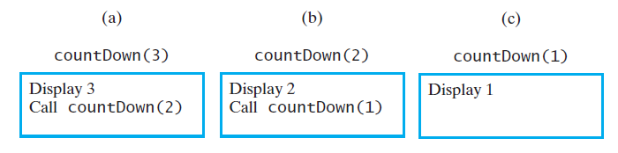
Tracing a Recursive Method
FIGURE 7-2 The effect of the method call countDown(3)
© 2015 Pearson Education, Inc., Upper Saddle River, NJ. All rights reserved.

Slide 11
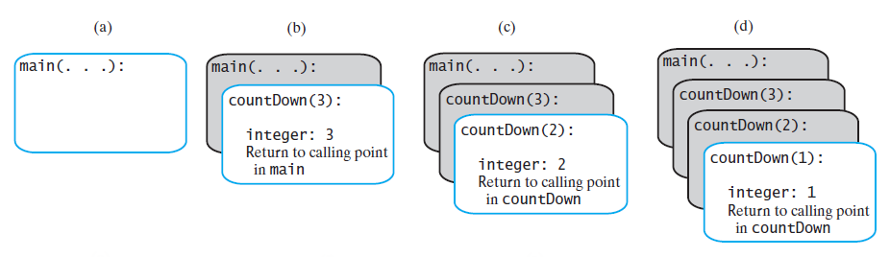
Tracing a Recursive Method
FIGURE 7-4 The stack of activation records during the execution of the call countDown(3)
© 2015 Pearson Education, Inc., Upper Saddle River, NJ. All rights reserved.

Slide 12
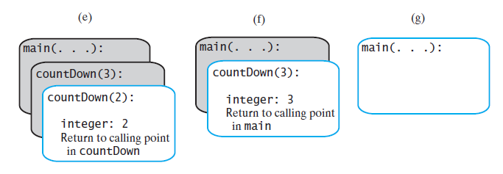
Tracing a Recursive Method
FIGURE 7-4 The stack of activation records during the execution of the call countDown(3)
© 2015 Pearson Education, Inc., Upper Saddle River, NJ. All rights reserved.

Slide 13
Stack of Activation Records
Each call to a method generates an activation record
Recursive method uses more memory than an iterative method
  Each recursive call generates an activation record
If recursive call generates too many activation records, could cause stack overflow
© 2015 Pearson Education, Inc., Upper Saddle River, NJ. All rights reserved.

Slide 14
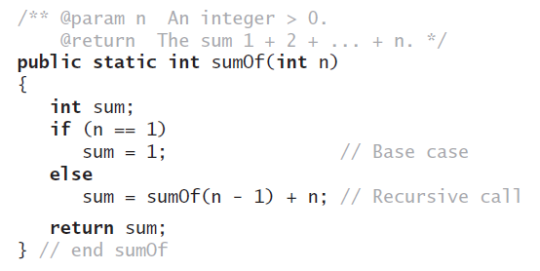

Recursive Methods
That Return a Value
Recursive method to calculate
© 2015 Pearson Education, Inc., Upper Saddle River, NJ. All rights reserved.

Slide 15
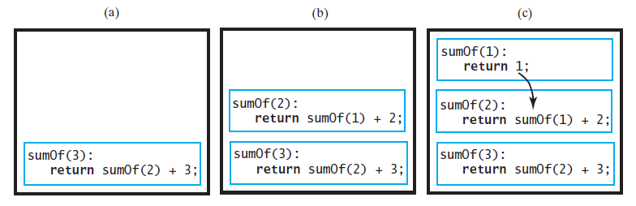
Tracing a Recursive Method
FIGURE 7-5 Tracing the execution of sumOf(3)
© 2015 Pearson Education, Inc., Upper Saddle River, NJ. All rights reserved.

Slide 16
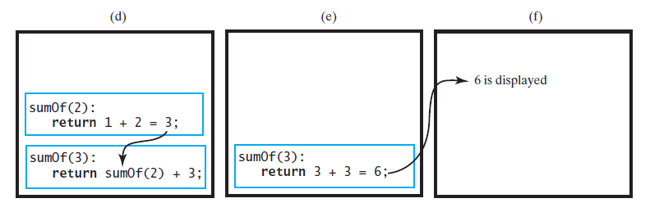
Tracing a Recursive Method
FIGURE 7-5 Tracing the execution of sumOf(3)
© 2015 Pearson Education, Inc., Upper Saddle River, NJ. All rights reserved.

Slide 17
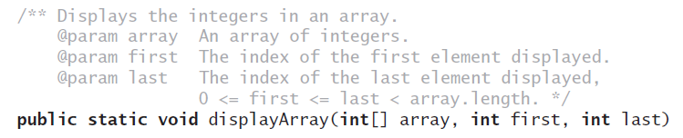
Recursively
Processing an Array
Given definition of a recursive method to display array.
© 2015 Pearson Education, Inc., Upper Saddle River, NJ. All rights reserved.

Slide 18
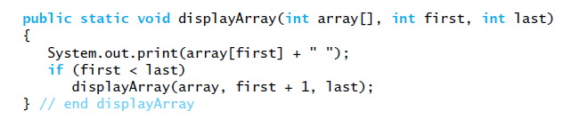
Recursively
Processing an Array
Starting with array[first]
© 2015 Pearson Education, Inc., Upper Saddle River, NJ. All rights reserved.

Slide 19
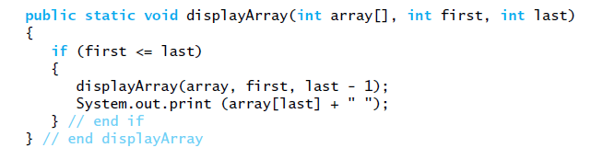
Recursively
Processing an Array
Starting with array[last]
© 2015 Pearson Education, Inc., Upper Saddle River, NJ. All rights reserved.

Slide 20

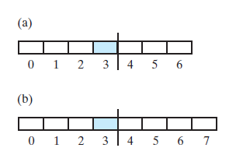
Recursively
Processing an Array
FIGURE 7-6 Two arrays with their middle elements within their left halves
© 2015 Pearson Education, Inc., Upper Saddle River, NJ. All rights reserved.

Slide 21
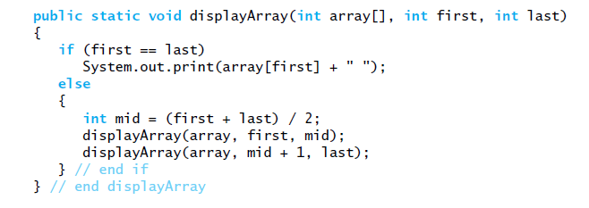
Recursively
Processing an Array
Consider
first + (last – first) / 2
Why?
Processing array from middle.
© 2015 Pearson Education, Inc., Upper Saddle River, NJ. All rights reserved.

Slide 22
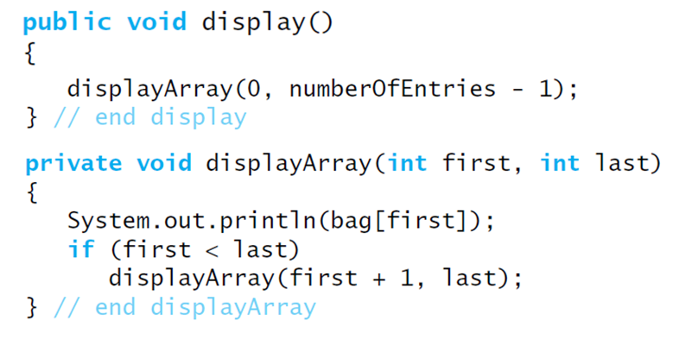
Displaying a Bag
Recursive method that is part of an
implementation of an ADT often is private.
© 2015 Pearson Education, Inc., Upper Saddle River, NJ. All rights reserved.

Slide 23
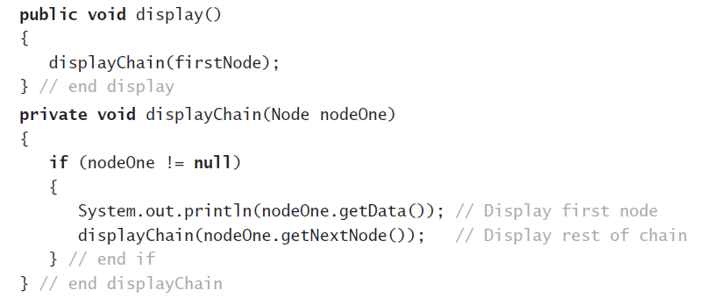
Recursively Processing a Linked Chain
Display data in first node and recursively
display data in rest of chain.
© 2015 Pearson Education, Inc., Upper Saddle River, NJ. All rights reserved.

Slide 24
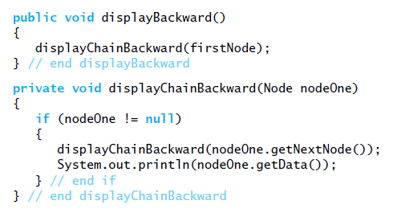
Recursively Processing a Linked Chain
Displaying a chain backwards. Traversing chain of linked nodes in reverse order easier when done recursively.
© 2015 Pearson Education, Inc., Upper Saddle River, NJ. All rights reserved.

Slide 25
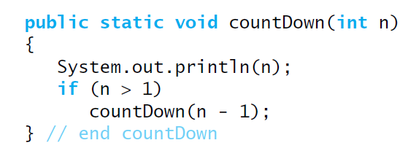
Time Efficiency of Recursive Methods
Using proof by induction, we conclude method is O(n).
© 2015 Pearson Education, Inc., Upper Saddle River, NJ. All rights reserved.

Slide 26
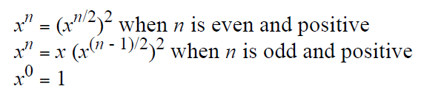
Time Efficiency of Computing x^{n}
Efficiency of algorithm is O(log n)
© 2015 Pearson Education, Inc., Upper Saddle River, NJ. All rights reserved.

Slide 27
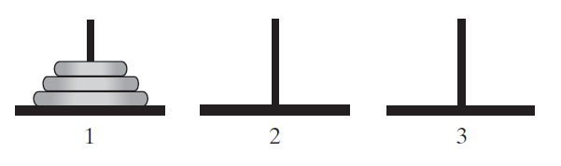
Simple Solution to a
Difficult Problem
FIGURE 7-7 The initial configuration of the
Towers of Hanoi for three disks.
© 2015 Pearson Education, Inc., Upper Saddle River, NJ. All rights reserved.

Slide 28
Simple Solution to a
Difficult Problem
Rules:
Move one disk at a time. Each disk moved must be topmost disk.
No disk may rest on top of a disk smaller than itself.
You can store disks on the second pole temporarily, as long as you observe the previous two rules.
© 2015 Pearson Education, Inc., Upper Saddle River, NJ. All rights reserved.

Slide 29
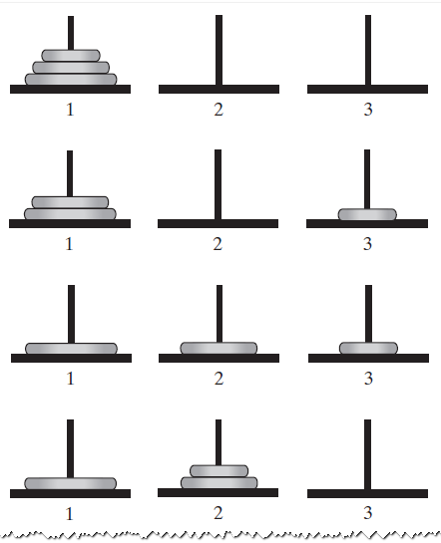
Solutions
FIGURE 7-8 The sequence of moves for solving the Towers of Hanoi problem with three disks
© 2015 Pearson Education, Inc., Upper Saddle River, NJ. All rights reserved.

Slide 30
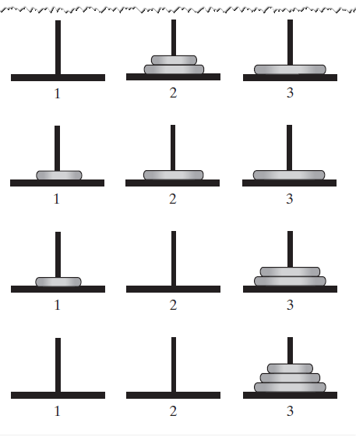
Solutions
FIGURE 7-8 The sequence of moves for solving the Towers of Hanoi problem with three disks
© 2015 Pearson Education, Inc., Upper Saddle River, NJ. All rights reserved.

Slide 31
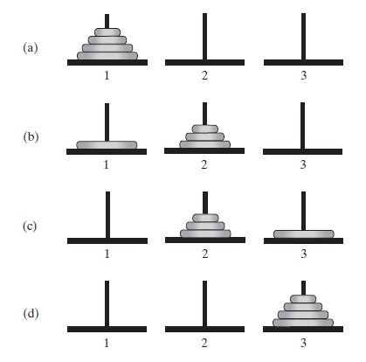
Solutions
FIGURE 7-9 The smaller problems in a recursive solution for four disks
© 2015 Pearson Education, Inc., Upper Saddle River, NJ. All rights reserved.

Slide 32
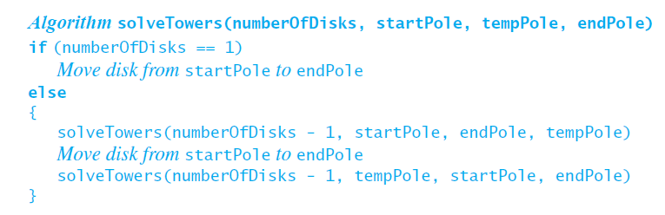
Solutions
Recursive algorithm to solve any number of disks.
Note: for n disks, solution will be 2^{n} – 1 moves
© 2015 Pearson Education, Inc., Upper Saddle River, NJ. All rights reserved.

Slide 33
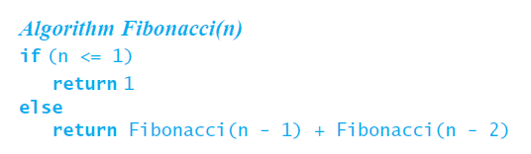
Poor Solution to a Simple Problem
Algorithm to generate Fibonacci numbers.
Why is this inefficient?
© 2015 Pearson Education, Inc., Upper Saddle River, NJ. All rights reserved.

Slide 34
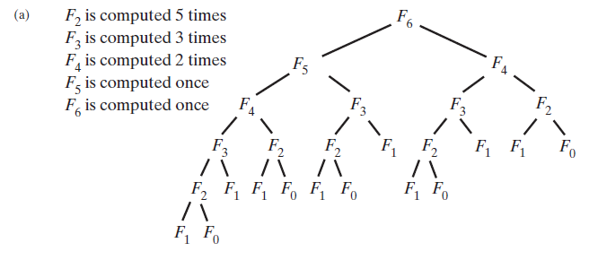
Poor Solution to a Simple Problem
FIGURE 7-10 The computation of the Fibonacci
number F₆ using (a) recursion … F_{n} = Ω(a^{n})
© 2015 Pearson Education, Inc., Upper Saddle River, NJ. All rights reserved.

Slide 35
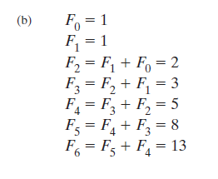
Poor Solution to a Simple Problem
FIGURE 7-10 The computation of the Fibonacci
number F₆ using (b) iteration.
© 2015 Pearson Education, Inc., Upper Saddle River, NJ. All rights reserved.

Slide 36
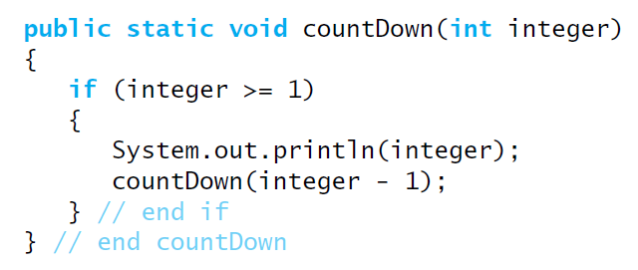
Tail Recursion
When the last action performed by a recursive
method is a recursive call.
© 2015 Pearson Education, Inc., Upper Saddle River, NJ. All rights reserved.

Slide 37
Tail Recursion
In a tail-recursive method, the last action is a recursive call
This call performs a repetition that can be done by using iteration.
Converting a tail-recursive method to an iterative one is usually a straightforward process.
© 2015 Pearson Education, Inc., Upper Saddle River, NJ. All rights reserved.

Slide 38
Indirect Recursion
Example
  Method A calls Method B
  Method B calls Method C
  Method C calls Method A
Difficult to understand and trace
  But does happen occasionally
© 2015 Pearson Education, Inc., Upper Saddle River, NJ. All rights reserved.

Slide 39
Indirect Recursion
Consider evaluation of validity of an algebraic expression
  Algebraic expression is either a term or two terms separated by a + or – operator
  Term is either a factor or two factors separated by a * or / operator
  Factor is either a variable or an algebraic expression enclosed in parentheses
  Variable is a single letter
© 2015 Pearson Education, Inc., Upper Saddle River, NJ. All rights reserved.

Slide 40
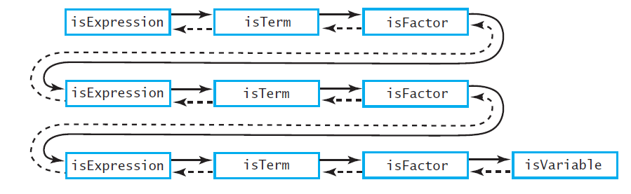
Indirect Recursion
FIGURE 7-11 An example of indirect recursion
© 2015 Pearson Education, Inc., Upper Saddle River, NJ. All rights reserved.

Slide 41
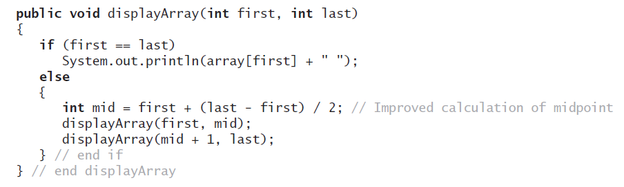
Using a Stack
Instead of Recursion
An example of converting a
recursive method to an iterative one
© 2015 Pearson Education, Inc., Upper Saddle River, NJ. All rights reserved.

Slide 42
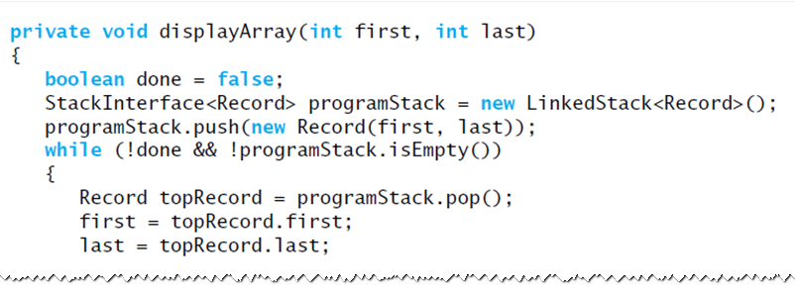
Using a Stack
Instead of Recursion
An iterative displayArray to maintain its own stack
© 2015 Pearson Education, Inc., Upper Saddle River, NJ. All rights reserved.

Slide 43
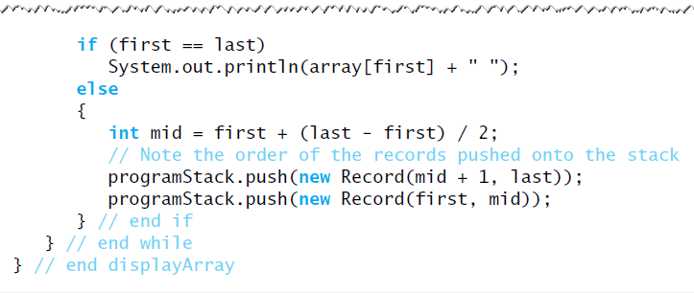
Using a Stack
Instead of Recursion
An iterative displayArray to maintain its own stack
© 2015 Pearson Education, Inc., Upper Saddle River, NJ. All rights reserved.

Slide 44
End
Chapter 7
© 2015 Pearson Education, Inc., Upper Saddle River, NJ. All rights reserved.

